Slide 1
Welcome to HOTT
Health Occupations for Today and Tomorrow

Slide 2
What do you want to be when you grow up?

Slide 3
A Teacher?

Slide 4
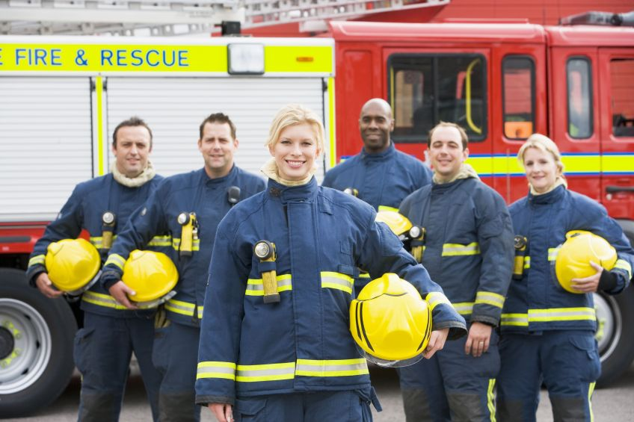
A Fireman?

Slide 5
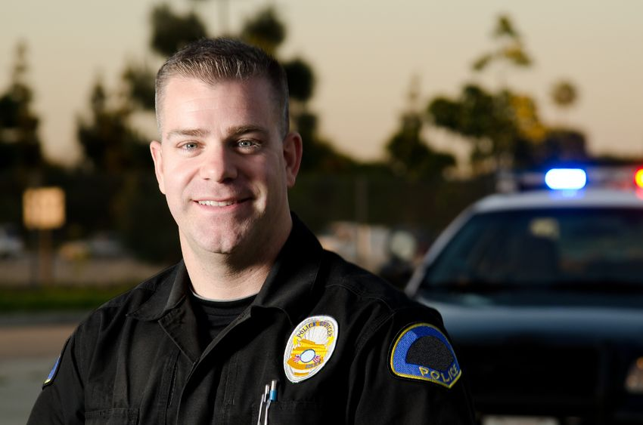
Maybe a Police Officer?

Slide 6
These are all very important jobs, but did you know there are a LOT of other jobs that help people every day?

Slide 7
Who has seen a doctor lately?

Slide 8
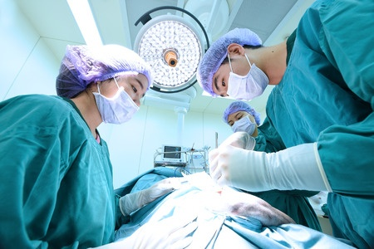
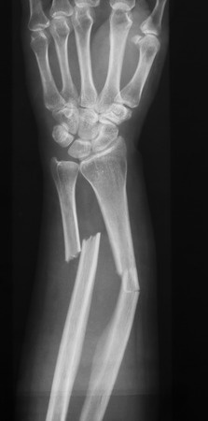
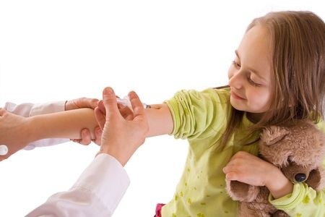
Did you have an operation?
Did you have a broken bone?
Did you get a shot?

Slide 9
Who helped you at the doctor’s office?

Slide 10
The ___________ took you to an exam room. She weighed you and took your temperature.
nurse

Slide 11
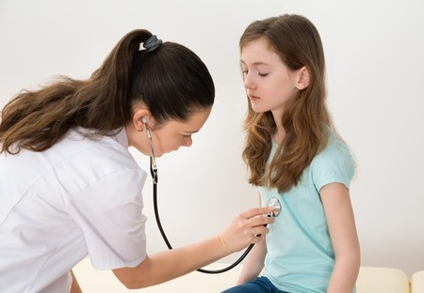
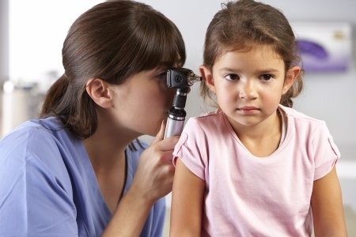
The ________ came into the exam room and looked into your ears, listened to your heart, and asked what was wrong today.
doctor

Slide 12
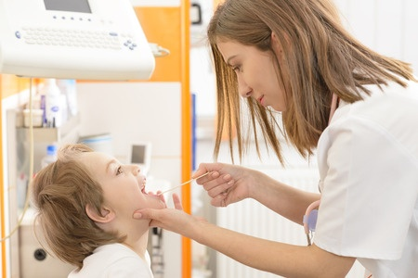
If you had a sore throat, the doctor would send you to see a __________.
lab tech

Slide 13
The lab tech uses a cotton swab to check your tonsils and looks at your sore throat germs to see if you need medicine.

Slide 14
If you have bacteria germs on your tonsils, you will see the ____________ to get medicine to make you feel better!
pharmacist
Remember! Never take medicine without an adult!

Slide 15
If you fell off your bike and hurt your leg, you would see the ______________.
radiology tech

Slide 16
The radiology tech uses a special machine to take pictures of your bones. These pictures are called X-rays.

Slide 17
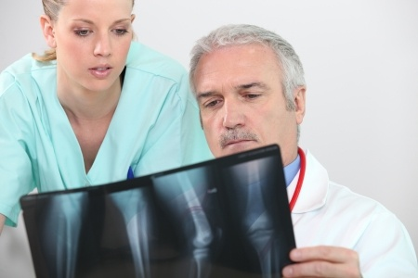
radiologist
A special doctor, called a ____________, will look at your X-ray to see if your bone is broken.

Slide 18
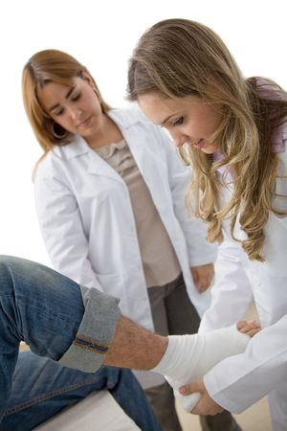
A special helper, called a ___________________, will put a cast around your broken bone.
physician assistant

Slide 19
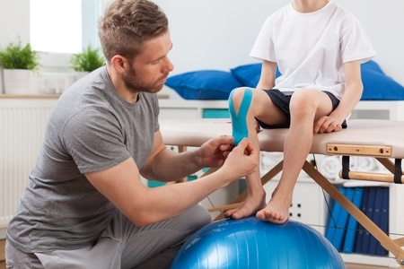
After your cast is removed, the __________________ will help you exercise so you can walk on it soon.
physical therapist

Slide 20
So next time you think about what you want to be when you grow up….

Slide 21
Remember your trip to the doctor’s office and ALL of the people who helped you!

